Slide 1
NGOs and Road safety
By. Dr. Mohammad Saadati
Road Traffic Injury Research Center

Slide 2
A definition
NGO is any non-profit, voluntary citizens' group which is organized on a local, national or international level, task-oriented and driven by people with a common interest.
NGOs perform a variety of service and humanitarian functions, bring citizen concerns to Governments, advocate and monitor policies and encourage political participation through provision of information. (United nations)

Slide 3
A definition
Private organizations that pursue activities to
relieve suffering,
promote the interests of the poor,
protect the environment,
and provide basic social services or undertake community development. (world bank 1995)

Slide 4
A definition
سازمان غیردولتی به تشكلهایی اطلاق می‌شود كه توسط گروهی از اشخاص حقیقی یا حقوقی غیرحكومتی به صورت داوطلبانه با رعایت مقررات مربوطه تأسیس شده و دارای اهداف غیرانتفاعی و غیرسیاسی می باشد.
موضوع فعالیت سازمان مشتمل بریکی ازموارد علمی ، فرهنگی ، اجتماعی ، ورزشی ، هنری ، نیکوکاری وامورخیریه ، بشردوستانه ، امورزنان ، آسیب دیدگان اجتماعی ، حمایتی ، بهداشت و درمان ، توانبخشی ، محیط زیست ، عمران وآبادانی و نظایرآن ، یا مجموعه ای ازآنها می باشد.
(آئین‌نامه اجرایی تأسیس و فعالیت سازمانهای غیردولتی)
طبقه بندی در 19 گروه

Slide 5
Some facts about NGOs:
There are an estimated 10 million non-governmental organizations (NGOs) worldwide.
If NGOs were a country, they would have the 5th largest economy in the world.
Nearly one in three (31.5%) people worldwide donated to charity in 2015 and one in four (24%) volunteered.
With over 3.3 million non-governme3ntal organizations, India has approximately one NGO for every 400 people.
Three out of four employees in the NGO sector are female.
First NGO was Anti-Slavery Society formed at 1839.

Slide 6
NGOs and Road Safety
Road traffic injuries (RTIs) stands as a public health problem
There is mutual relation among RTIs and socio-economical/ cultural situations.
Communities could have big role in RTIs prevention.
Community based movements are the core of social changes.

Slide 7
NGOs and Road Safety; common modes
Created by people who have been directly affected by a RTI
Membership-based, promoting the rights of specific groups of road users
Some are oriented towards road safety research or policy
Some call for, or themselves implement, discrete road safety projects around key factors
Advocacy

Slide 8
Added value of advocacy by NGOs
Drawing attention to road safety generally;
Creating political will to address road safety;
Correcting public misconceptions about the causes and preventability of road traffic crashes;
Promoting changes in current national policies and programs regarding both prevention and services, including rehabilitation for physical and psychological trauma;

Slide 9
Added value of advocacy by NGOs
Conveying messages to the general public about the need to change specific behaviors;
Building effective partnerships and coalitions;
Increasing funding for policies and programs to support road safety and road traffic injury victims;
Generating a demand for road safety from the public

Slide 10
NGOs initiatives for RTIs advocacy
Review and analyze status of road safety in the country
Identify political mechanisms which influence the creation or modification of legislation
Engage partners
Define goals and objectives
Develop a strategy
Develop advocacy materials
Organize events
Identify champions
Engage the media

Slide 11
NGOs and Road safety; Experiences
Jalisco state of Mexico
Víctimas de Violencia Vial (VIVIAC), Established in 2009
“Legislating for Life” movement about drinking and driving laws
Methods: interview with vicitims, policy makers, establishing citizens representative group,
Resulted in change in law as:
upper limit on the level of blood alcohol concentration (BAC) at 0.05 g/dl down from 0.15 g/dl for the general driving population and
BAC limit of 0.00 g/dl for drivers of public transport vehicles

Slide 12
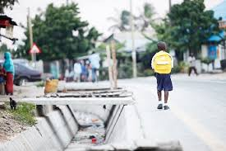
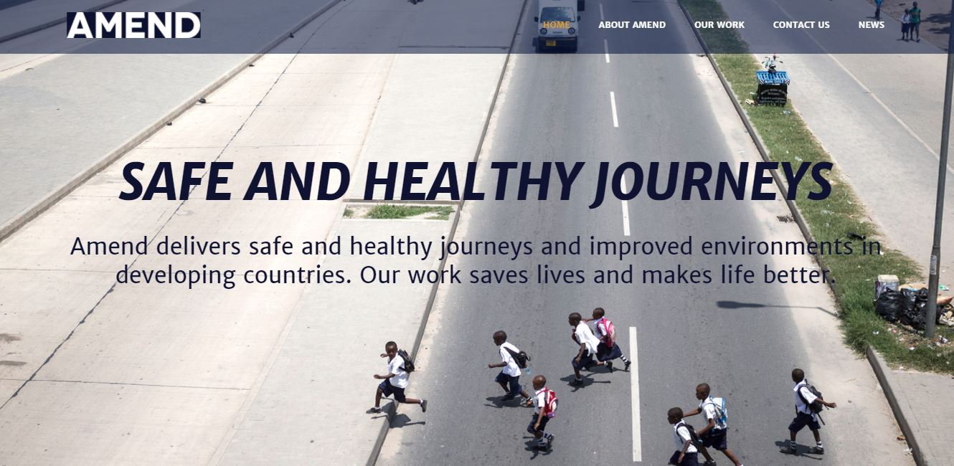
NGOs and Road safety; Experiences
Visibility of school children on roads in Ghana and Tanzania
Amend NGO
Social marketing on "See & Be Seen”; reflector-enhanced school bags
Engaging manufacturers, government and schools

Slide 13
NGOs and Road safety; Experiences
YOURS: Youth for Road Safety
Global youth-led NGO established in 2010
Mission: lobby for road safety among young people around the world .
Social media is the main tool
Capacity building of youth around the world

Slide 16
International supports
The Global Alliance of NGOs for Road Safety
Established in 2011 by NGO members of the United Nations Road Safety Collaboration
More than 250 member NGOs from more than 90 countries
Goals: Networking and sharing, Advocacy and capacity building.

Slide 17
سازمان های مردم نهاد ترافیکی در ایران
جمعیت طرفداران ایمنی راهها
بهبود وضعیت ایمنی تردد در راهها و ارتقای فرهنگ ترافیکی کشورمی باشد.
دارای نمایندگی های استانی
از جمله فعالیت ها:
برگزاری همایش های آموزشی و فرهنگی برای گروههای هدف
آموزش همگانی از طریق رسانه ها و انتشارات
مشارکت در برگزاری همایش های تخصصی

Slide 18
سازمان های مردم نهاد ترافیکی در ایران
انجمن خیرین راه و ترابری
ایجاد بستر و تسهیل امکانات حمل و نقل در نقاط نیازمند، آسیب دیده و محروم
دارای نمایندگی های استانی
از جمله فعالیت ها:
تامین مالی و اجرای عملیات عمرانی توسعه راهها در مناطق محروم
ارتقاء ایمنی راه‌هاي مناطق محروم و نیازمند از طریق فرهنگ‌سازی و تأمین تجهیزات و تسهيلات ميان راهي
جلب مشارکت ذينفعان صنعت حمل و نقل به منظور جذب منابع و هدايت به سمت اهداف انجمن

Slide 19
سازمان های مردم نهاد ترافیکی در ایران
Road Safety Pioneers
ارتقای فرهنگ ایمنی ترافیک از طریق ارتقای آگاهی گروههای هدف
از جمله فعالیت ها:
برگزاری کارگاههای آموزشی برای دانش آموزان، رانندگان حرفه ای و...
راه اندازی و اجرای کمپین های فرهنگی

Slide 20
All, give a big hand for safer roads
Thank you

