Slide 1
Traumatic Brain Injury How it may affect driving performance
Presented by Nasrin Shahedifar
19.08.2020

Slide 2
Outline
The Brain, its lobes and functions
What TBI is and Epidemiology
Types of brain injuries
Classification of TBI
Symptoms
Importance of driving
How can TBI affect driving ability

Slide 3
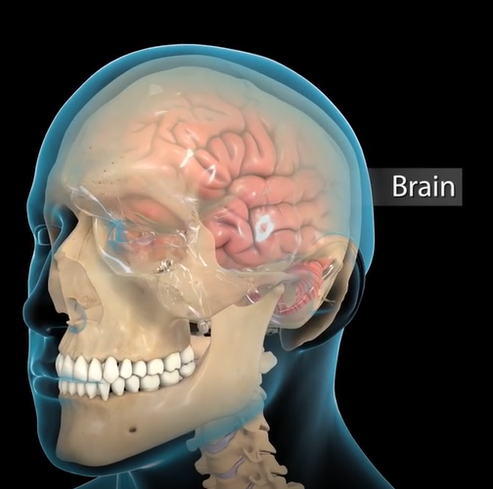
The Brain
Seat of intelligence
Database of memories
Interpreter of the senses
Director of all movements
Notes:
The brain is the most complex part of the human body.
This three-pound organ is the seat of intelligence, database of memories, interpreter of the senses, and the director of all movement, lying in its bony shell and washed by protected fluid. The brain is also the most fragile organ in the body with the same texture and consistency as gelatine.

Slide 4
the lobes of the brain
Notes:
The first part the presentation deals with the lobes of the brain and their functions. There are the frontal lobe, parietal lobe, the temporal lobe, the occipital lobe, and the cerebellum.

Slide 5
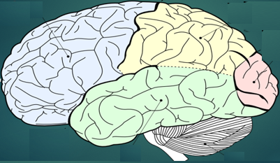
Frontal lobe
Sequencing
Decision making
Attention
Personality
Problem solving
Verbal expression
Spontaneity
Emotions
Movement initiation
Notes:
The frontal lobe: it controls certain of our behaviours and certain of the things we do and when it is injured that has certain consequences.
The changes are seen when there is an injury to the frontal lobe include:
Problems with sequency, there is difficulty making decisions, people experience decreased attention, changed personality, problem solving difficulties, a decrease in their ability to verbally express themselves, a lack of spontaneity, uncontrolled emotions, social and sexual behaviors, decreased initiation of voluntary movements.

Slide 6
Temporal lobe
Spoken word
Selective attention
Sexuality
Aggression
Identification
Categorization
Facial recognition
Locating objects
Notes:
The changes that we see when the temporal lobe is injured is that people have problem understanding the spoken word, there are problems with selective attention, sexuality changes,
A person with a temporal lobe injury may be found a persistently talk. And an increase in aggressive behaviour, there are problems identifying objects and categorizing them and there are problems recognizing faces and finding objects.

Slide 7
Parietal lobe
Object classification
Tactile processing
Academic skills
Cognitive ability
Directional understanding
Hand-Eye coordination
Spatial orientation
Notes:
Now, let’s talk a little bit about the parietal lobe. The parietal lobe is an area of the brain that takes us into sort of a higher level of functioning and as we look at the parietal lobe and those changes we see in patients with TBI difficulty naming objects, processing their tactile sensations, so problems processing and understanding what their fingers are telling them they are touching. You see people’s academic skill sets fall and things that they were easily able to in the workplace or in the academic setting from a cognitive standpoint are now diminished or gone. There is confusion between the left and the right, they have a loss of hand-eye coordination and a decreased orientation of where our bodies are in space.

Slide 8
Occipital lobe
Vision
Visual field
Location objects
Color identification
Hallucinations
Word blindness
Movement perception
Reading/ writing
Visual processing
Notes:
You see issues of vision defects, there is loss of visual field, there are problems visually locating objects, importantly here are problems identifying colours, people can have distorted vision, hallucinations, they can have something called word blindness, there is the inability to perceive the way that objects move and obviously there are problems with reading and writing and there is an overall slowed processing of the way that our brains process visual information.

Slide 9
Cerebellum
Voluntary motor skills
Balance
Equilibrium
Coordination
Postural controls
Eye movement
Notes:
When we look at the cerebellum, that’s the area here it really at the back and the base of the brain at the top of the spinal column. We see the control of motor coordination. We see all of our voluntary motor coordination so when we decide we want to reach out and grab a jar off the shelf, we put our arm out and we do that and that is our cerebellum in action. We have our balance and our equilibrium, the ability to stand up and not fall over, the ability to be able to ride a skateboard, to be able to ride a bicycle, our postural control and our eye movements moving eyes back and forth up and down and utilizing our eyes to obtain visual information so that it can be processed by our brain.

Slide 10
Brain stem
Body temperature
Heart rate
Breathing
Balance
Movement
Swallowing
Notes:
So our brain stem controls so much of what happens in our body. It controls so many of the different functions that allow us to survive as human beings. The ability to hold our body temperature to keep it at a healthy temperature as opposed to getting too hot or too cold, the ability to manage efficiently effectively our heart rate or the rate at which we breathe, people experience problem with balance and their movement, swallowing food and liquids.
When any of the lobes of our brain is damaged or injured either by an accident by a driver, by drug it is a horrible consequence. It effects our lives in myriad ways.

Slide 11
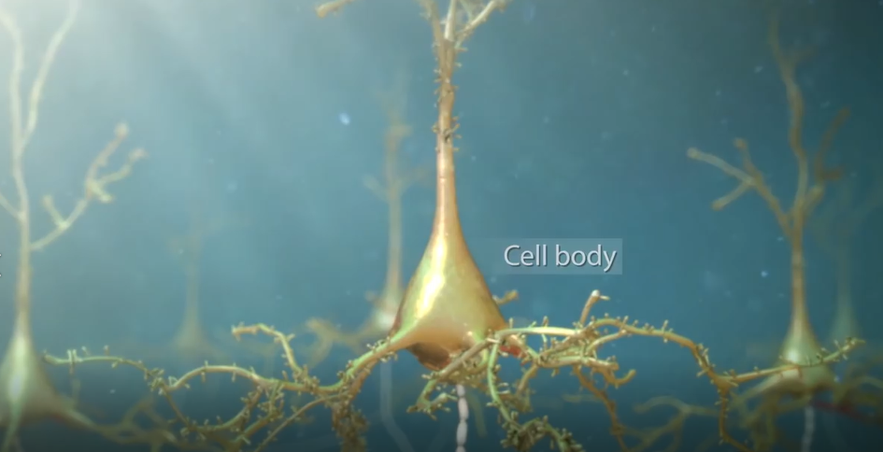
Nerve cells
Neurons:
Sending electrical and
chemical signals to and from the body
Axon
Extend out from the cell body
Provide extensive interconnections with other brain areas
Dendrites
Projections of the cell body
Receive messages from other neurons
Notes:
Within the brain are over 100 billion nerve cells called neurons sending electrical and chemical signals to and from the body. Each neuron has a cell body and a long nerve fibre called an axon and projections of the cell body called dendrites. Dendrites extend out from the cell body to receive messages from other nerve cells. Axons in the brain connect neurons with each other, which in turn provide extensive interconnections with other brain areas.

Slide 12
Traumatic Brain Injury
external forces cause damage to the brain
types of forces: mechanical, thermal, chemical, electrical, radiation
Epidemiology:
about 1.7 million people have a TBI each year
Mortality rate is 30/100,000, about 50,000 deaths each year (Lizzo JM and M. 2020 )
more instances in males than females
the highest rate of TBIs occurred in age category 21‒30 (Riahi R., et al., 2018)
Transport accidents were the most common cause of TBIs (76.4%) (Riahi R., et al., 2018).
Notes:
There is a lot of stuff to talk about with this topic. I am gonna start braking this down with an overview. We talk about traumatic brain injury or something that we refer to as TBI and so what this is essentially when we have some sort of external force that is gonna to be causing damage to the brain and this can be the result of many different types of forces so things from mechanical, thermal, chemical, electrical or even radiation can technically cause damage to the brain.

Slide 13
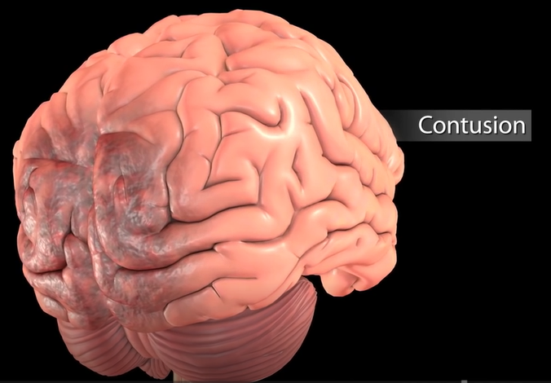
Brain injuries
coup countercoup or acceleration deceleration injury
Contusion: High speed coup countercoup injury
the impact may be violent enough to cause swelling and bruising of the brain tissue
Diffuse axonal injury (DAI):
Axons experience tremendous shearing forces causing exons to stretch and tear from the cell body
Notes:
Because the brain and its nerve cells are so fragile, sudden rapid movements of the head can cause injuries. During one such injury called coup countercoup or acceleration deceleration injury the brain bounces back and forth against the bony interior wall of the skull. In high speed coup countercoup injury, the impact may be violent enough to cause swelling and bruising of the brain tissue called a contusion. Axons experience tremendous shearing forces causing them to stretch and tear from the cell body. This event is called diffuse axonal injury (DAI).

Slide 14
Brain injuries
low-speed coup countercoup injuries
Damage to axons:
degenerate releasing toxic levels of chemicals called neurotransmitters into the extracellular space
Notes:
However, in cases involving low-speed coup countercoup injuries, the resulting damage may not be visible to the naked eye. Brain damage can continue to occur for hours or days after the initial injury. Damage to the axons can lead to a breakdown of communication among neurons in the brain. The torn axons quickly degenerate releasing toxic levels of chemicals called neurotransmitters into the extracellular space. In turn, many of the surrounding neurons begin to die over the next 24 to 48 hours worsening the initial effects of the injury.

Slide 15
Classification of Brain Injury
based on the severity
Mild, Moderate, Severe Traumatic Brain Injury
based on the pathological features
Glasgow Coma Scale:
GCS score 13-15
GCS score 9-12
GCS score 3-8
Notes:
Next we talk about the different ways in which we classify these brain injuries and we can really classify these injuries in one of two ways. The first is based on the severity and the other is gonna be based on the pathological features. if we talk about the severity scale this Is where we are going to see three different severe levels. We have what we call mild, moderate and severe.
There are a couple of different things that we can look at but the most common of these is gonna be to use what we call the Glasgow Coma Scale as our primary assessment tool for classifying this severity of TBI. The higher GCS score that we have is actually gonna be associated with better outcomes for our patients.
Don’t discount the effects of even an mTBI because this injury can potentially last a lifetime although a majority of people with mTBI will fully recover within just a few weeks

Slide 16
Symptoms
Mild-moderate cases of Dai may result in symptoms such as
Brief loss of consciousness
Impaired long-term memory
Reduced problem-solving ability
Lower social inhibition
Problems with attention and perception
20%–70% of mTBI patients suffer from persistent functional, cognitive and/or neuropsychological symptoms at or beyond 3 months post injury (Debbie Y., et al., 2020).
Notes:
Mild to moderate cases of diffuse axonal injury or Dai may result in symptoms such as
Patients are at significant risk of psychiatric sequelae and cognitive impairment post injury. It is estimated that 20%–70% of mTBI patients suffer from persistent functional, cognitive and/or neuropsychological symptoms at or beyond 3 months post injury

Slide 17
Symptoms
Severe cases of Dai may result in
Coma
Persistent vegetative state.

Slide 18
Importance of Driving
Driving is basically your independence
the 1st thing they usually ask about very commonly is when can I start driving again
Part of your community reintegration
Method of control
They drive with a privilege not a right
Notes:
We want to keep in mind that every other brain injury is unique and not everyone will fit into what we are speaking about.
First obviously we are gonna talk about the importance of driving. Driving is basically your independence and about people with TBI, the 1st thing they usually ask about very commonly is when can I start driving again because that is your independence. It is also part of your community reintegration. it is part of getting back into the community, going to places where your friends are, going to work, going to school, going to family functions and so on, going to the grocery every day. It is also method of control when you are driving you are in control of the car and that is something that everyone wants and one thing I put at the bottom of this is they are driving with a privilege not a right. And that is something we have all said at one point of our lives.

Slide 19
Driving after TBI
Their driving skills are no longer the same
TBI can have cognitive, behavioral, physical effects
Family, friends and caregivers may also be worried about their loved one driving safely after a TBI
Person with the TBI is oftentimes worried about driving again
Notes:
People who have sustained a brain injury often find that their driving skills are no longer the same. Obviously, TBI can have cognitive effects. It can have behavioral effects. It can have physical effects and all of those combined are just a little bit of each and make driving quite different after they have had any kind of brain injury. Family, friends and caregivers may also be worried about brain injury about whether a person can drive safely, obviously if they are probably even more so if there is a TBI came from a car accident or motorcycle accident but I think everyone will worry about their loved one driving safely after a TBI. The person with the TBI is oftentimes worried about driving again. They may be very scared to go back on the road they may be scared around other drivers. they may only want to drive it for part of the day and things like that.

Slide 20
Driving after TBI
They place limitations on their driving:
Do not like to drive at night, long distances, get on the highway.
Take side roads, drive when they are feeling okay.
A lack of awareness into their deficits
Difficulties with visual stimuli
Notes:
People with TBI may place limitations on their driving they do not like to drive at night, they do not like to drive long distances, or get on the highway. They may only take side roads, they may only be willing to drive when they are feeling okay. So people may place some limitations. People with TBI have a lack of awareness into their deficits. They may have a lack of awareness into what they are still able to do without support or with support and if you are not able to recognize that obviously that is an increased risk for the person driving and for everyone around. people also can experience difficulties with visual stimuli which can affect their driving performance when it comes to seeing the big picture.

Slide 21
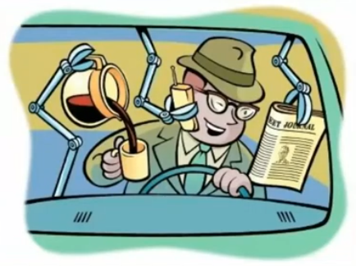
How can TBI affect driving ability?
Brain enjoys the multitasking experience
Notes:
This is a funny picture but literally some of us may have done this himself. The person is talking on the phone, reading the paper, typing a text message, making their coffee, eating their food, scolding the person in the back seat. So it is a multitasking experience. You have to pay attention to several things at once which we know is difficult for everyone, let alone have a brain injury.

Slide 22
TBI can affect many physical, cognitive and behavioral skills needed to drive well
Physical:
Reduced strength and coordination
Hearing loss, Tinnitus (ringing or buzzing in the ears)
Headaches
fatigue
Notes:
TBI can affect the many physical, cognitive and behavioral skills needed to drive well. So when to talk about those physical skills.
Reduced strength and coordination: a lot of times people with brain injury may have tremors, they may be weaker on one side coordination. Coordination is certainly multitasking.
Hearing loss: your hearing can be affected after TBI
Tinnitus (ringing or buzzing in the ears): you may have tinnitus which is a ringing or buzzing in the ears
Headaches: are very common and when you have a bad headache, or you may not feel well and that could affect your driving performance.
Obviously fatigue: people especially initially can be very fatigued very easily and if you even have a lack of awareness about that, that could be a double whammy.

Slide 23
Vision
Not just clarity: depending on where in the brain the injury occurred.
Central vision
Peripheral vision: to see things out of the corner of their eye
Perceiving spatial relationships
Notes:
not just clarity: Vision can be very affected by brain injury depending on where in your brain your injury occurred. This is not just clarity that can provided by contacts or glasses.
Good peripheral vision: being able to see things out of the corner of their eye and that is something that is often affected after TBI.
Perceiving spatial relationships, positioning your vehicle remain in line with traffic, other cars.

Slide 24
Seizures
The Indiana law states that anyone who is actively having seizures, if they have statement from their physician stating that they are under medication and their seizures are being controlled, they may not be denied a license.
A person whose license is revoked for medical reasons is distinguished that they are suspended for driving violations.
Notes:
A sudden condition in which someone cannot control the movements of the body, it continues for a short time.
They often have seizures after brain injury, not always but often.
The Indiana law states that anyone who is actively having seizures, if they have statement from you physician stating that you are under medication and his seizures are being controlled and they are seizure free. A person whose license is revoked for medical reasons is distinguished that they are suspended for driving violation.

Slide 25
TBI can affect many physical, cognitive and behavioral skills needed to drive well
Cognitive
Reaction time
Judgment
Concentration
Multitasking
Memory
Confusion
Notes:
TBI can also affect the many physical cognitive and behavioral skills needed to drive so we are talking about the cognitive skills.
Obviously when they are driving they need to be able to react. they need to be able to react quickly to the other cars, people that can walk out in front of them.
Judgment: you have to be able to present good judgment which you know can be very affected by brain injury.
Concentration: you have to be able to concentrate. It is very difficult to maintain focus and concentrate. In order to drive you have to be able to concentrate. Multitasking we discussed.
Memory: it is a huge very common deficit with short tern after brain injury and if they are driving, they are going to forget which direction they are going into, that can certainly throw them off.
Confusion: being able to not remember where you are or getting confused about you know which one is the gas pedal, which one is the brake pedal. I mean all kinds of things can happen with their cognitive skills.

Slide 26
TBI can affect the many physical, cognitive and behavioral skills needed to drive well
Behavioral skills
Road rage: yelling, and even running other drivers off the road
Serious aggression: threats to other drivers, passengers, or their vehicles; two thirds of all traffic fatalities (NHTSA, 2020)
Risky driving behaviors: those actions that increase the objective likelihood of a crash or the severity of injury; differed by gender and age.
Notes:
They may have some sort of behavior deficits.
yelling, and even running other drivers off the road are all signs of road rage. Now researchers have found a connection between that road rage and prior traumatic brain injury. Road rage is actually quite common now in the world, with brain injury that is more exacerbated.
Serious driver aggression includes threats to other drivers, passengers, or their vehicles. The National Highway Traffic Safety Association (NHTSA) and the Auto Vantage auto club report that two thirds of all traffic fatalities are the result of road rage or aggressive driving.

Slide 27
THANK YOU
Drive Safe.

