Slide 1
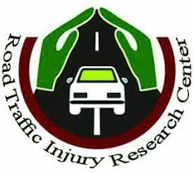
Journal Club
Hold by Road Traffic Injury Research Center
Tabriz university of Medical Sciences
June 2020
The Elderly Driving Performance
The Neurological Prospective
Fatemeh Jahanjoo

Slide 2
Outline
Problem Statement
Dilemma of termination of diving in the elderly
Exposure to risk in elderly drivers

Slide 3
Questions

Slide 4
Development of human societies
Increase in the number of the elderly over the past 50 years
growth rate of 1.9% (aging population) vs. 1.2% (global population)

Slide 5
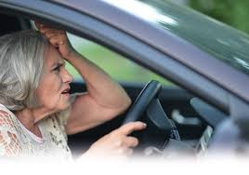
Increased age- related problem with increased number of the elderly (risky driving behavior)
elderly people and growing lifestyles

Slide 6
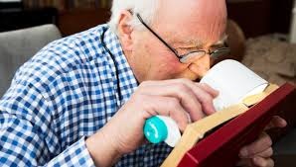
Physical
Anatomic
and Psychological functioning
Notes:
On the other hand

Slide 7
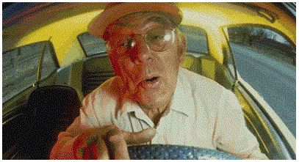
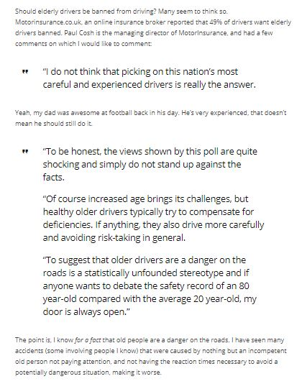
Should Old People be Banned from Driving?
WWW.automoblog.net
an example of the prejudice against elderly drivers that is largely unsupported by scientific research…

Slide 8
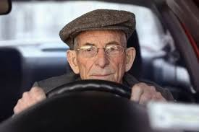
Should Old People be Banned from Driving?
dynamic life
social relationships
self- confidence

Slide 9
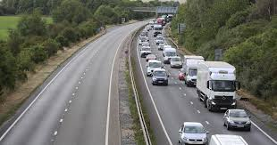
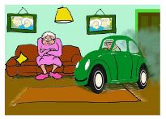
Problems of assessing exposure to risk
I am doing it for 25 yrs.,
that should be fast enough for anybody!
Prefer:
familiar roads
Low speeds
Avoid
night driving
heavy traffic
difficult situations

Slide 10
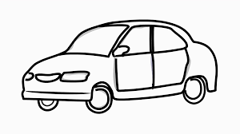
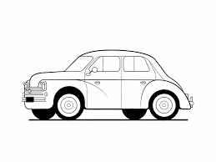
Why are elderly drivers more at risk?
Visual problems?
Attentional Problems? (UFOV)
Information processing problems?

Slide 11
References
Azami-Aghdash S, Aghaei MH, Sadeghi-Bazarghani H. Epidemiology of Road Traffic Injuries among Elderly People; A Systematic Review and Meta-Analysis. Bulletin of emergency and trauma. 2018;6(4):279-91.
Cartagena LJ, Kang A, Munnangi S, Jordan A, Nweze IC, Sasthakonar V, et al. Risk factors associated with in-hospital mortality in elderly patients admitted to a regional trauma center after sustaining a fall. Aging clinical and experimental research. 2017;29(3):427-33.
Kaimila B, Yamashina H, Arai A, Tamashiro H. Road traffic crashes and fatalities in Japan 2000-2010 with special reference to the elderly road user. Traffic injury prevention. 2013;14(8):777-81.
Reimer B. Driver Assistance Systems and the Transition to Automated Vehicles: A Path to Increase Older Adult Safety and Mobility? Public Policy & Aging Report. 2014;24(1):27-31.

